Slide 1

Cognitive Function in Lupus
Leslie J Crofford, MD
Wilson Family Chair in Medicine
Professor of Medicine and Pathology, Microbiology & Immunology
Chief, Division of Rheumatology & Immunology

Slide 2
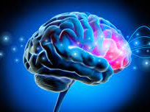
Defining Cognition
The American Psychological Association defines cognition as “all forms of knowing and awareness, such as perceiving, conceiving, remembering, reasoning, judging, imagining, and problem-solving.” Along with affect (emotions) and conation (motivation, intent), it is one of the three traditionally identified components of the mind.

Slide 3
Cognitive Functions
Attention
Pattern-matching
Problem-solving
Memory
Learning
Decision-making
Language
Mental processing
Perception
Imagination
Logic
Strategic thinking

Slide 4

Making Sense of Cognitive Functions
Hot Cognition:
Emotions/Motivation
Cold Cognition:
Neutral, Raw Information Processing
Sensory-Perceptual
Attention
Memory
Executive Functions

Slide 5

Executive Functions
Attention Control
  Selective attention or choosing what to focus on and what to ignore
  Divided attention or “multitasking”
Working Memory
  Temporarily holding and manipulating information in real time
  Verbal, visuospatial, episodic buffering capacity
Inhibitory Control
  Stopping of a thought or impulse
  Self-regulation
Cognitive Flexibility
  Ability to “shift gears” or take new perspectives
  Related to problem-solving and creative thinking

Slide 6

Higher Order Executive Functions
Relational reasoning and logic
Decision-making
Planning
Problem-solving

Slide 7

Where does cognition happen?
Frontal lobe, especially the pre-frontal cortex
  Higher order cognitive abilities and executive functions
Parietal lobe
  Sensation and perception
Occipital lobe
  Visual cognition
Temporal lobe
  Memory, speech, auditory data
Memory and learning are widely distributed across the brain

Slide 8

What are cognitive resources?
Knowledge structures – how information is connected
Biological resources – your brain needs energy for the synapses to work
Mental resources – you can use old knowledge to help current thinking
Blocking resources – emotions, fear, old memories can block remembering
Attentional scope – people differ on “fine detail” versus “broad scope”
Access and availability – not everything we know can be accessed all the time
Housekeeping – sleep, idle time, relaxation allows “clean up”

Slide 9
Cognition in Lupus

Slide 10
Causes of Cognitive Impairment
Specifically related to lupus autoimmunity
Neuropsychiatric lupus (NPLE)
Antiphospholipid syndrome
Related to associated conditions
Pain, fibromyalgia
Depression
Fatigue, insomnia
Related to medications
Pain medication
Seizure medications
Steroids

Slide 11
American College of Rheumatology Classification for NPLE - 1999
*
*
*
*
*
Prevalence 37-95% considering all possible manifestations
Excluding conditions common in general population (*), still present in 19-38%
Specificity of diagnosis increases by excluding “mild” common conditions from 46% (coin toss) to 93%

Slide 13
Why might lupus itself cause cognitive impairment?
Blood-brain barrier (BBB) usually keeps the brain separate from normal circulation
If the BBB becomes leaky, things that circulate in lupus (e.g., autoantibodies, cytokines) could enter the brain and cause changes
How does the BBB become leaky?
  Infections
  Blood vessel damage
  Severe stress
There is no single blood test that predicts or can diagnose lupus brain or cognitive disease

Slide 15
How common is cognitive dysfunction or “lupus fog”?
Mild to moderate in 14-95%
Severe in 3-5%
Commonly affected domains
Attention
Visual memory
Verbal memory
Executive function
Psychomotor speed

Slide 16
Factors Associated with More Severe Impairment
Hypertension
Anti-phospholipid antibodies
Strokes
Abnormalities on MRI

Slide 17
“Lupus Fog”
Common
Often difficult to tell if directly related to lupus
Affects lupus patients differently, e.g.
  Difficulty word finding
  Trouble remembering small details
  Difficulty with daily tasks
Typically waxes and wanes
Does not usually progress to severe cognitive dysfunction/dementia
Different than “psychosis”

Slide 18
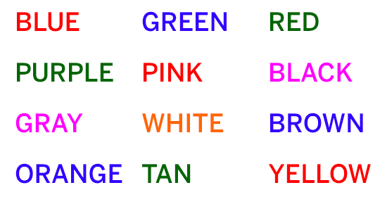
How do you diagnose cognitive dysfunction?
Neuropsychiatric testing
MRI
  To look for strokes or inflammation
  But can be normal in up to 50% of people with any kind of NPLE

Slide 19
What about co-occurring conditions?
VERY HARD to determine if cognitive dysfunction is related to active lupus, damage from past lupus activity, or something else
FOR EXAMPLE
Fibromyalgia is present in about 30% of patients with lupus
Associated with cognitive dysfunction
Domains affected in fibromyalgia are similar to those affected in lupus AND of normal aging

Slide 20
Cognitive Changes Across the Lifespan
Digit Symbol
1.2
Letter Comparison
Pattern Comparison
0.8
Letter Rotation
Line Span
0.4
Computation Span
Z-scores
Reading Span
0
Benton
-0.4
Rey
Cued Recall
-0.8
Free Recall
n = 350
Shipley Vocabulary
-1.2
Antonym Vocabulary
20's
30's
40's
50's
60's
70's
80's
Synonym Vocabulary
Age Groups

Slide 21
Cognitive Protocol
Speed of processing: digit, pattern & letter comparison [overall neural integrity]
Working Memory: reading span set A, computation span, reading span set B [frontal and parietal]
Verbal fluency: three letters, F A S [frontal]
Free recall: three lists of sixteen words [hippocampal and frontal]
Recognition memory: three lists of 32 words [hippocampal]
Vocabulary: synonyms, Shipley vocabulary, antonyms
Park et al. A&R, 2001

Slide 22
Working Memory
32
30
28
p < .039
26
FM vs AMC
24
22
Number Correct Trials
20
18
16
14
12
10
FM
Older
Age-Matched
Controls
Controls
Park et al. A&R, 2001

Slide 23
Verbal Fluency
65
60
p < .014
55
FM vs AMC
50
Number of Words
45
40
35
30
FM
Older
Age-Matched
Controls
Controls
Park et al. A&R, 2001

Slide 24
Long-Term Memory
Free Recall
31
29
27
p < .025
FM vs AMC
25
Number of Words Recalled
23
21
19
17
15
FM
Older
Age-Matched
Controls
Controls
Park et al. A&R, 2001

Slide 25
Vocabulary
55
50
p < .002
FM vs AMC
45
Number Correct
40
35
30
FM
Older
Age-Matched
Controls
Controls
Park et al. A&R, 2001

Slide 26
Information Processing Speed
150
p = .80
FM vs AMC
140
130
120
Number Correct
110
100
90
80
FM
Older
Age-Matched
Controls
Controls
Park et al. A&R, 2001

Slide 27
Potential Approaches to Manage “Lupus Fog”
Exercise
  May help fatigue, depression, pain, circulation
Improve sleep
Review medication list
Stimulant drugs – Double edged sword (I do not usually recommend)
  Caffeine
  Modafanil (Provigil, Sparlon)
  Methylphenidate (Ritalin, Concerta, Focalin)
  Amphetamines (Adderall, Vyvanse)
Aspirin or anticoagulants IF anti-phospholipid antibodies
IF acute and severe cognitive changes thought due to active lupus
  Steroids, Cytoxan, Rituxan

Slide 28
Tips for Coping with “Lupus Fog”
Write it down
Say it out loud
Stay organized
Prioritize
Time your activities
Stretch your memory
Keep up good habits
From WebMD

Slide 30
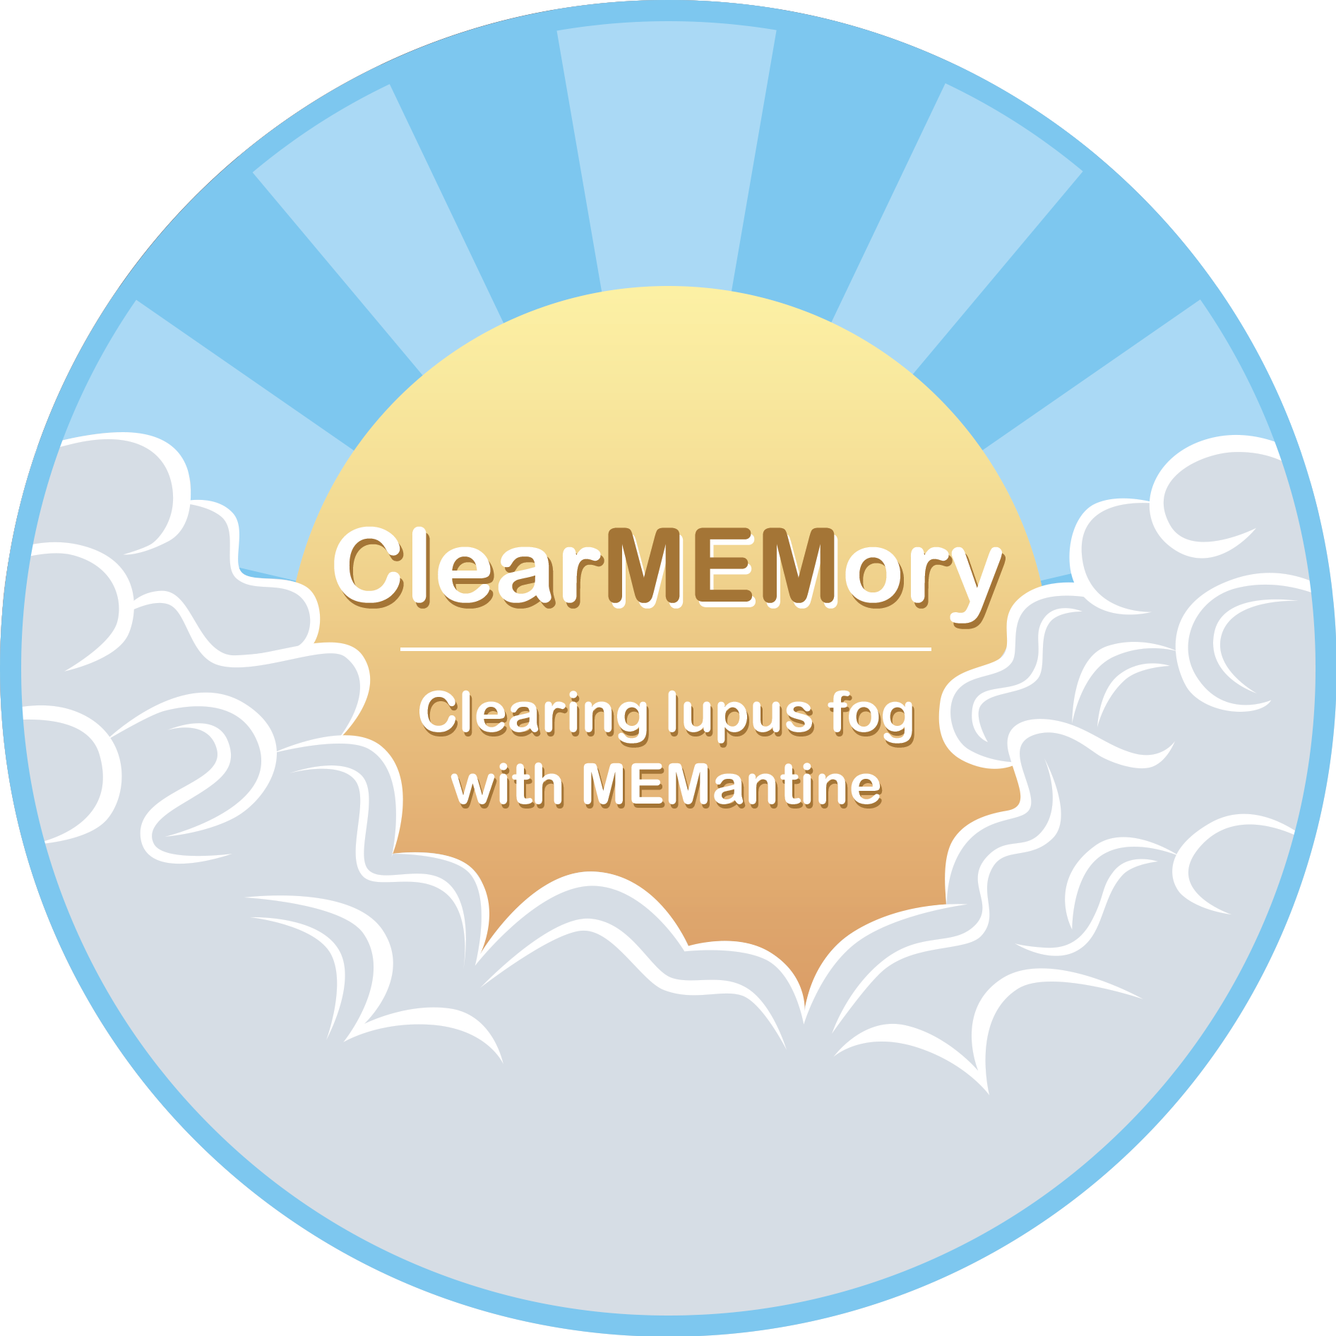
Memantine
Approved by the FDA for patients with dementia
Works on a specific brain receptor for a chemical called NMDA
Patients with lupus can have antibodies that recognize this receptor
We identified genetic variations in this receptor in some patients with NPLE

Slide 31
ClearMEMory
Age 18-70
Diagnosed with lupus by a physician
Have cognitive dysfunction or “lupus fog”
Willing to come to Vanderbilt University Medical Center
  Screening visit (1-2 hours, blood collection, cognitive testing - RBANS)
  3 additional visits to adjust treatment and assess response
jonathan.m.williams@vumc.org or 615-875-9200
leslie.j.crofford@vumc.org

Slide 32

Questions?

